Slide 1

ESTIMATION OF BUSINESS EXPENSES
1.INTRODUCTION:
1.1.Overview
Business expenses are costs associated with running a company.When you know all of a company’s expenses,you can create a more accurate budget and track spending.Expenses are also a part of a company’s income sheet.You must know a business’s expenses to calculate a final net profit.Costs are substracted from revenue to deetermine a company’s taxable income.

Slide 2

1.2.Purpose
An expenses is a cost that businesses incur in running their operations.Expenses include wages,salaries,maintenance,rent,and depreciation.Expenses are deducted from revenue to arrive at profits.Businesses are allowed to deduct certain expenses from taxes to help alleviate the tax burden and bulk up profits.

Slide 3

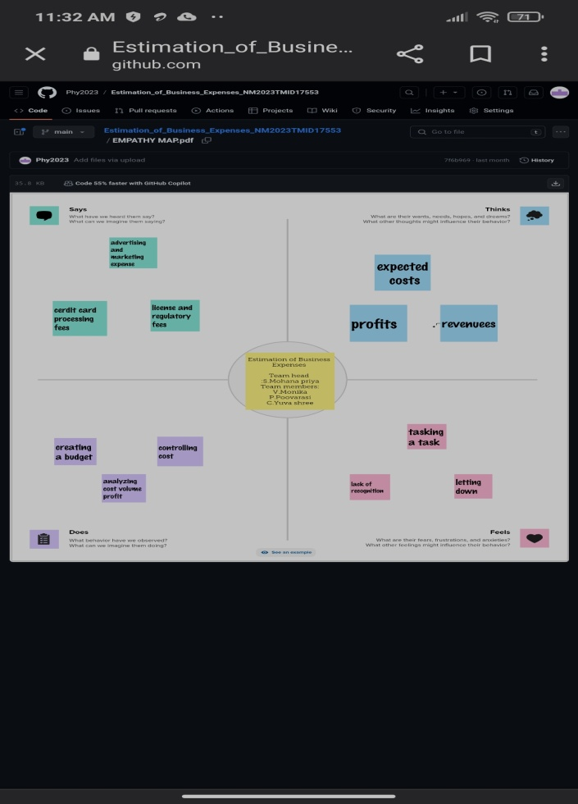
2.PROBLEM DEFINITION & DESIGN THINKING
2.1.Empathy Map

Slide 4

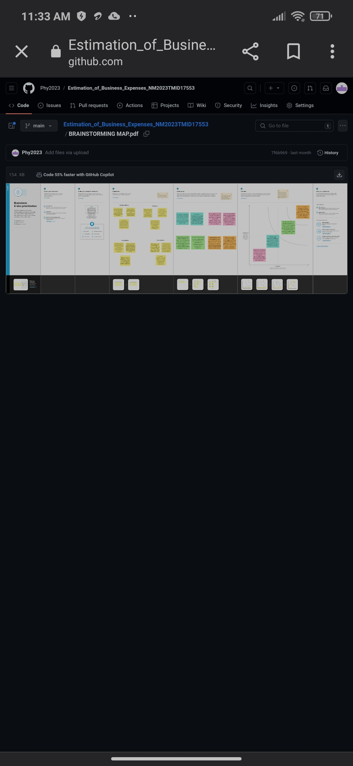
2.2.Ideation & Brainstorming Map

Slide 5

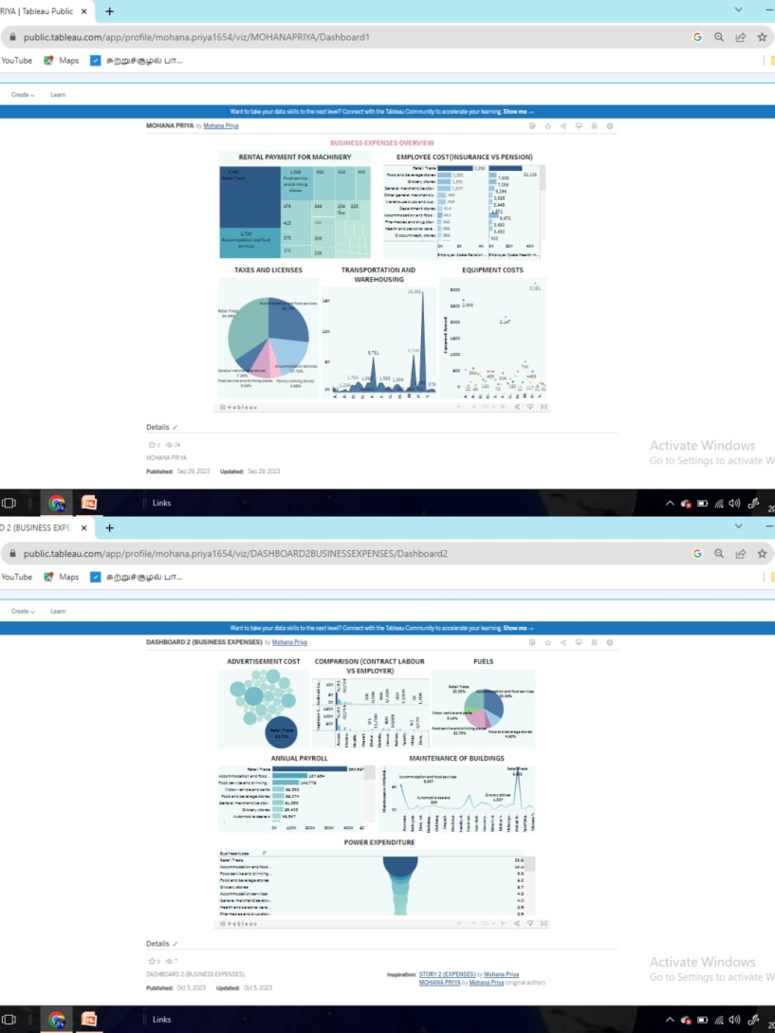
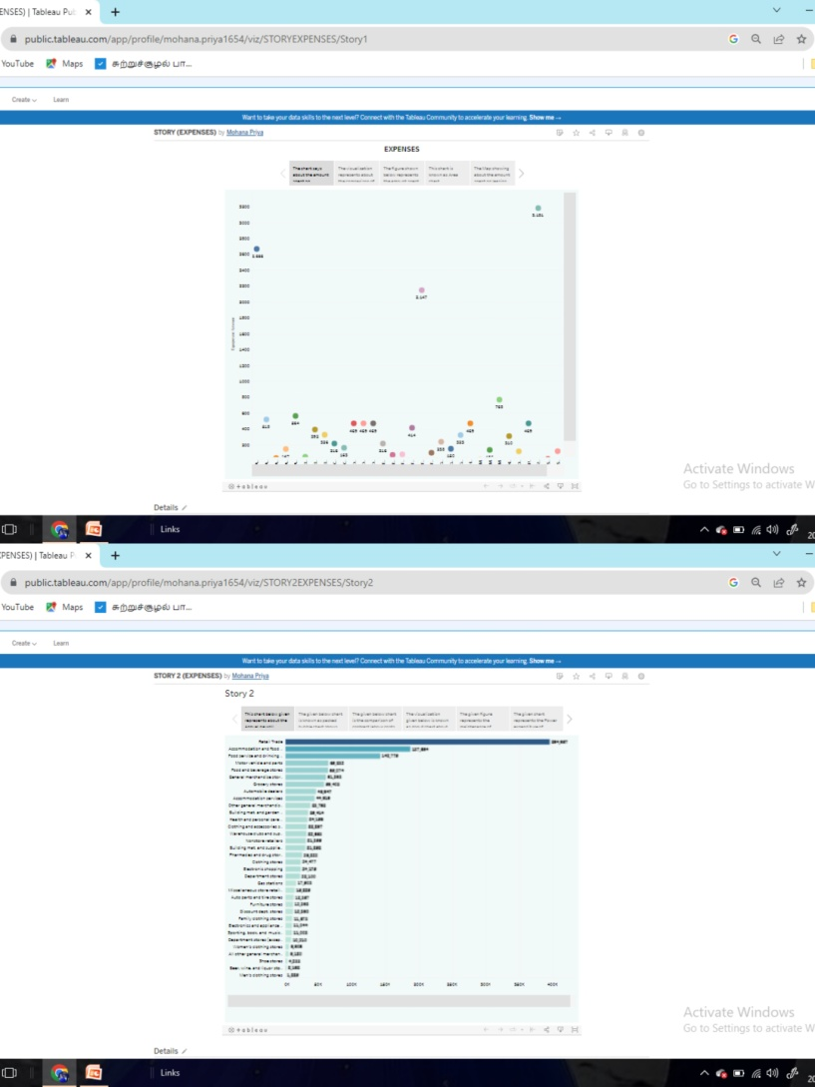
3.RESULT

Slide 6

4.ADVANTAGES & DISADVANTAGES
Advantages:
1.It helps you forecast future steps
2.It is required if you want to apply for credit
3.It helps you to identify future cash flow issues
4.It helps you to allocate resources
5.It helps you better understand your competition.
Disadvantages:
1.It may not be accurate
2.It can make you become ‘tunnel-visioned’
3.It can waste precious time and money.

Slide 7

5.APPLICATIONS
In short,business expenses appear directly in the income statemant and indirectly in the balance sheet.It is useful to always read both the income statemnt and the balance sheet of a company.So that the full effect of an expenses can be seen.

Slide 8
6.CONCLUSION
By building this project(Business Expenses) of empathy and brainstorming map and data analytics gives us the output of easy understandable of to sum up,keeping track of business expenses is an essential aspect of running a successful company.It helps you to make informed financial decisions and stay on top of your cash flow.

Slide 9
7.FUTURE SCOPE
1.Mobility
2.Travel booking
3.Integrated system
4.Optical character recognition
5.Artificial intelligence
In 2023 alone,around 19000 startup businesses started in India. This shows the bright scope for new business ideas and ventures.

